Slide 1
Internship experience report
Apprentice : Phạm Thị Hà Trang Department : Qmm6.2
Date : Oct - 2023

Slide 2
Content
Internship experience report
1
Experiences and lessons – learned
2
Support department for improvements

Slide 3
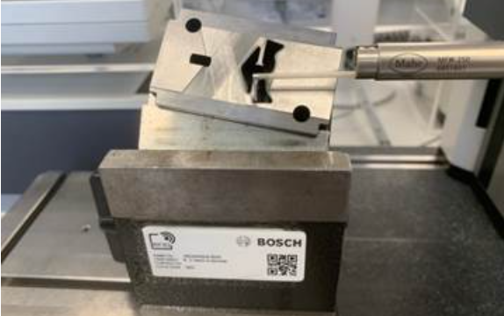
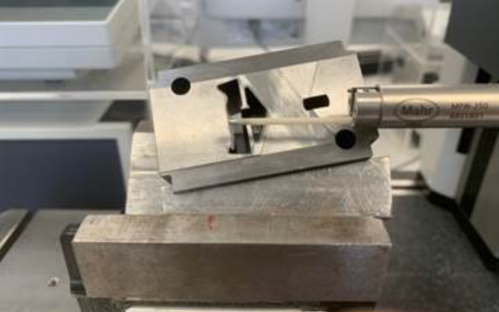
Support department for improvements
Internship experience report
1. Roughness of cutting plates measurement.

Slide 4
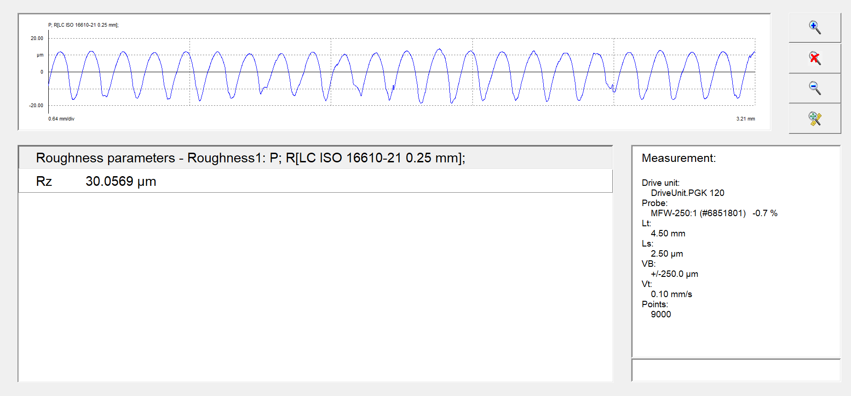
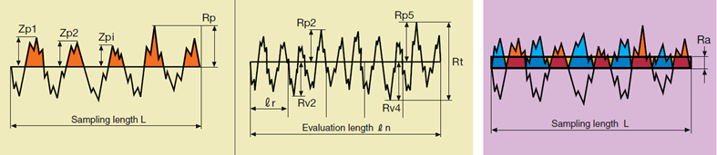
Support department for improvements
Internship experience report
1. Roughness of cutting plates measurement.

Slide 5
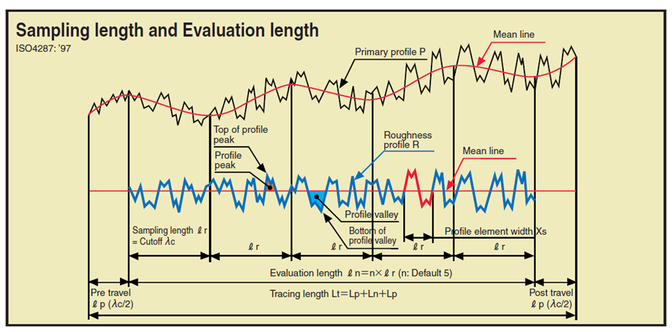
Support department for improvements
Internship experience report
Sampling length and evaluation length

Slide 6
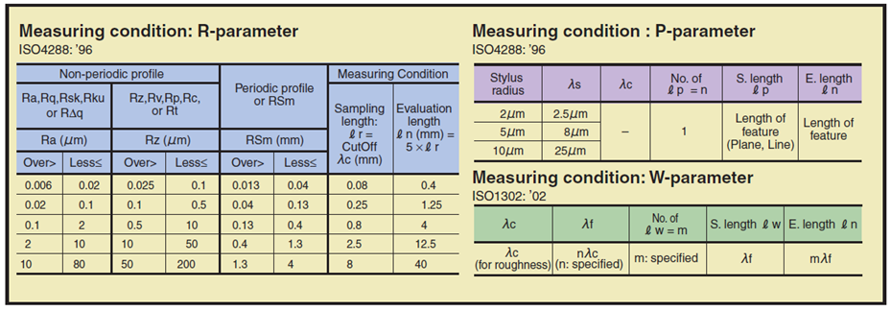
Support department for improvements
Internship experience report
Sampling length and evaluation length

Slide 7
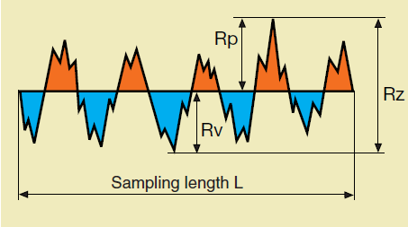
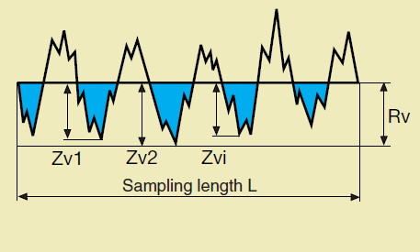
Support department for improvements
Internship experience report
Sampling length and evaluation length

Slide 8
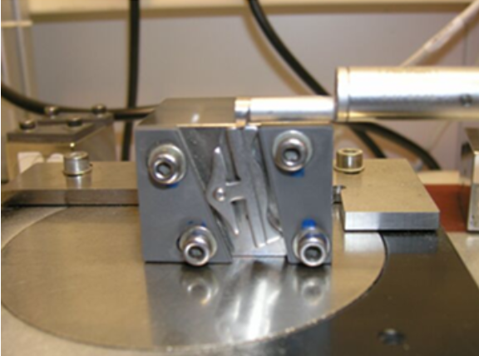
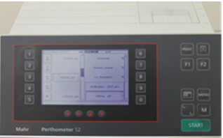
Support department for improvements
Internship experience report
Sampling length and evaluation length

Slide 9
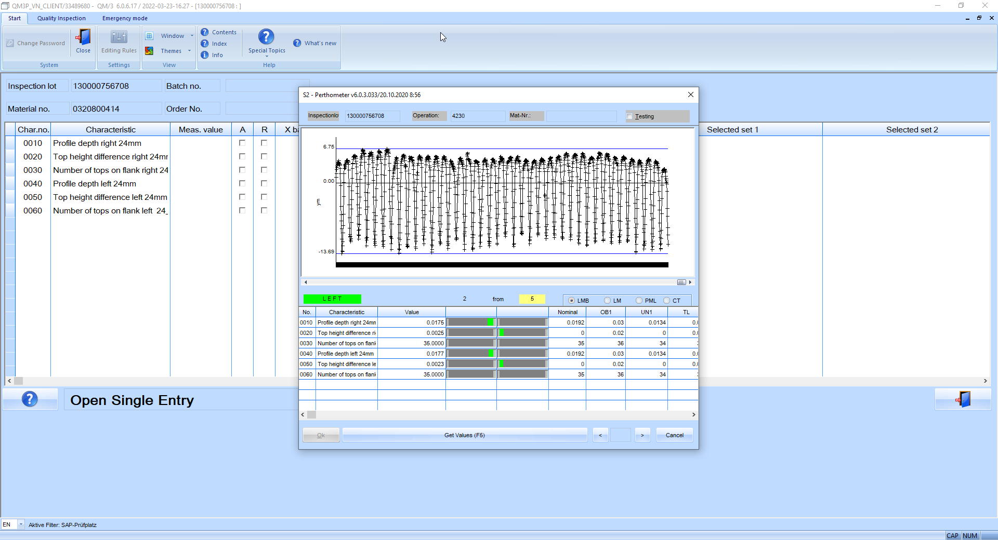
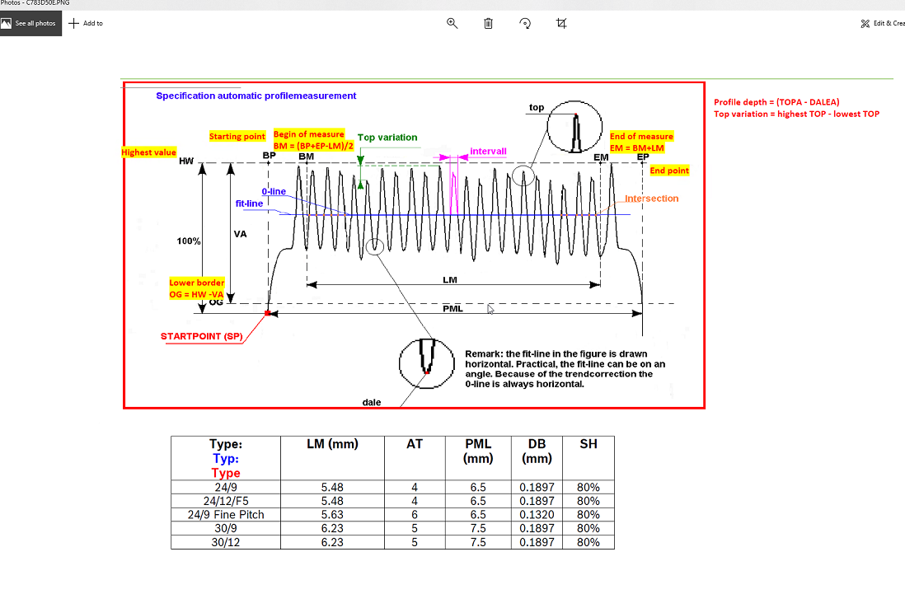
Support department for improvements
Internship experience report
Sampling length and evaluation length

Slide 10
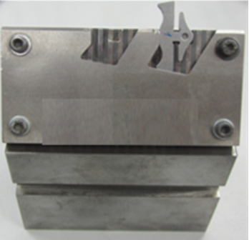
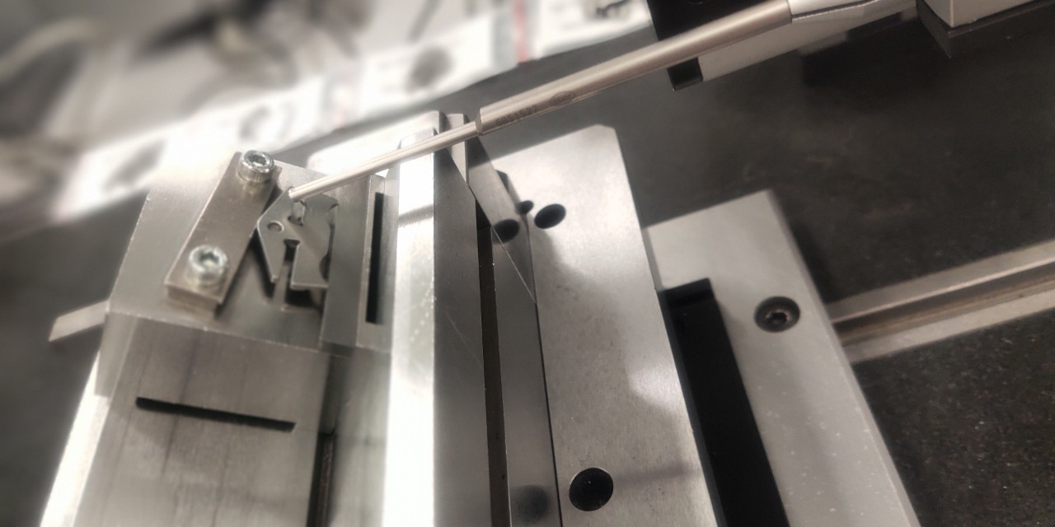
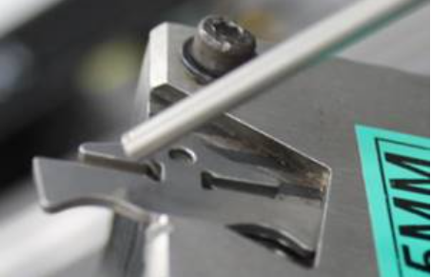
Support department for improvements
Internship experience report
Sampling length and evaluation length

Slide 11
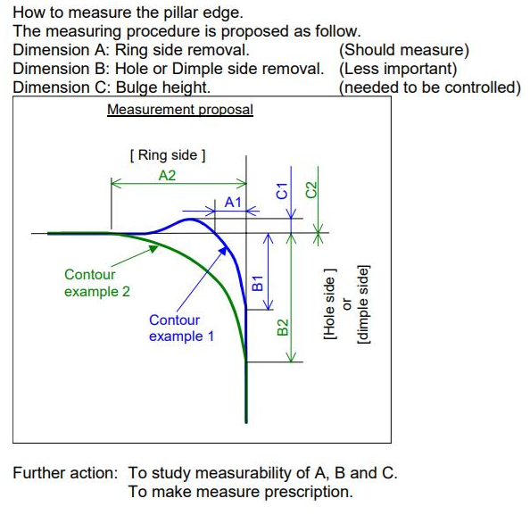
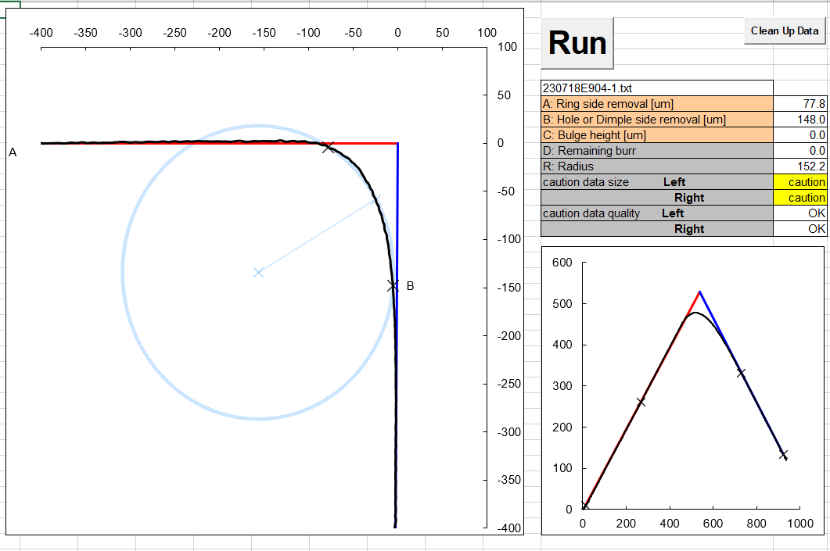
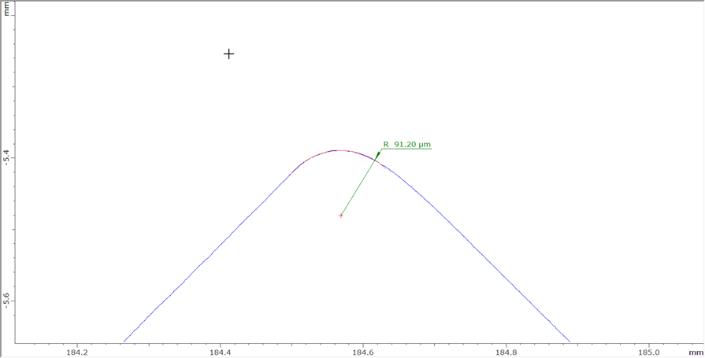
Support department for improvements
Internship experience report
Sampling length and evaluation length

Slide 12
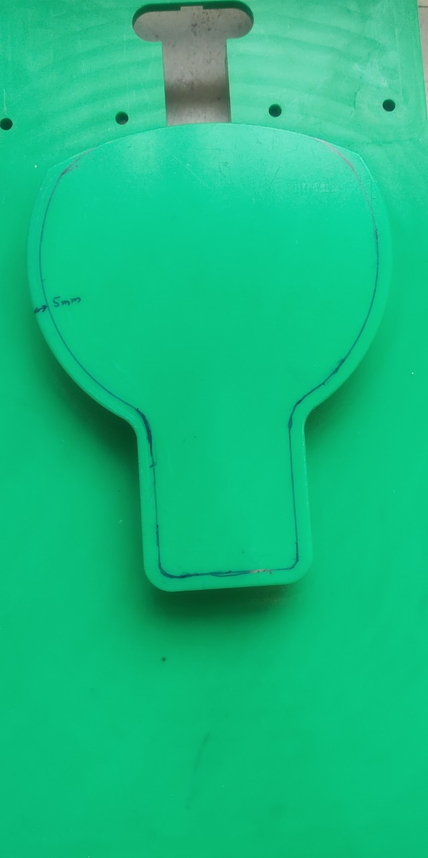
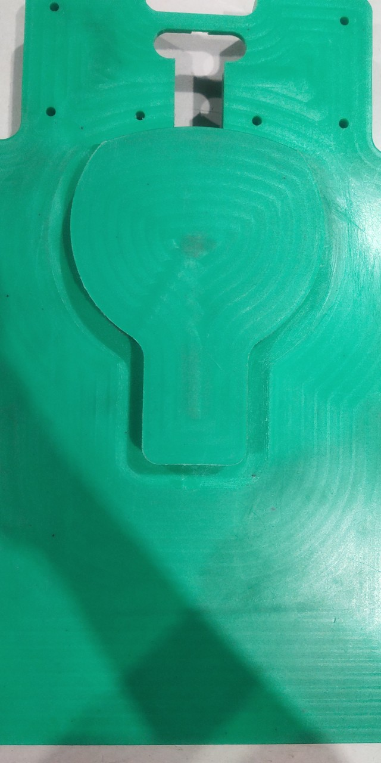
Support department for improvements
Internship experience report
1. Improvement about a part of loop thickness machine.

Slide 13
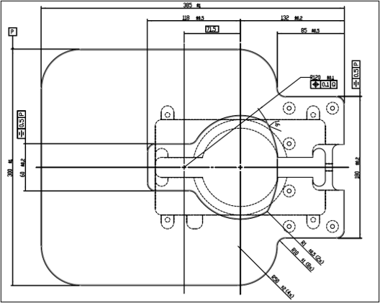
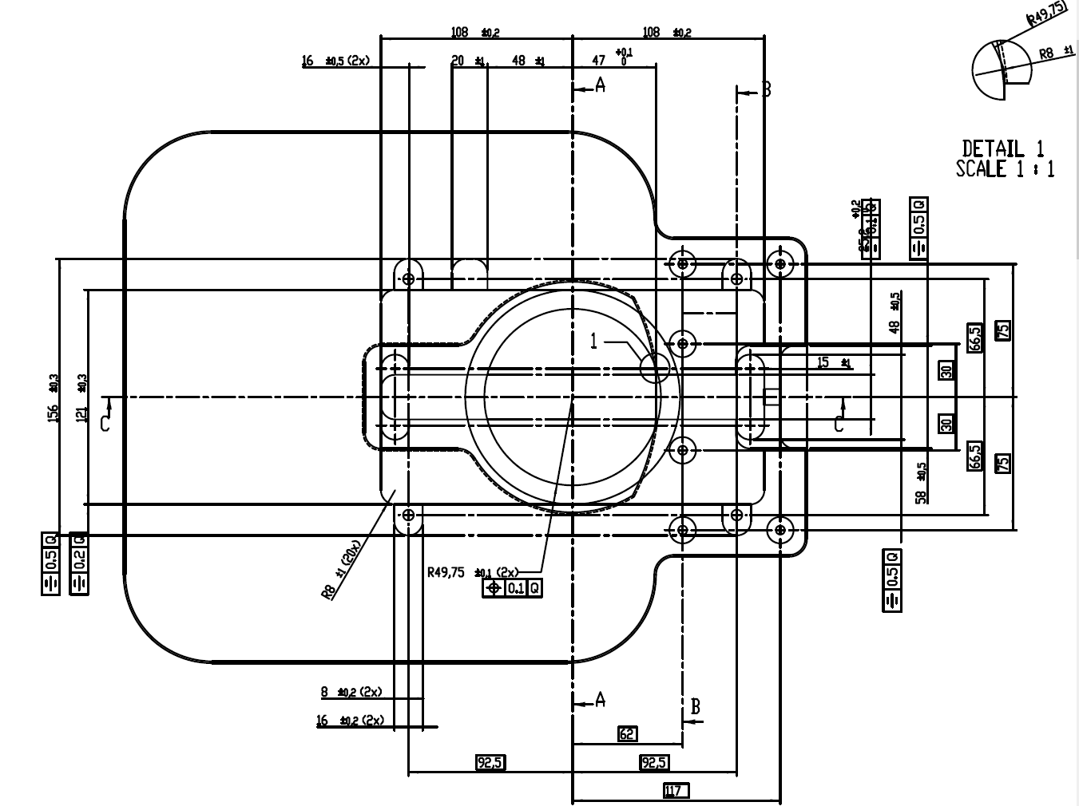
Support department for improvements
Internship experience report
Drawing of loop thickness part.

Slide 14
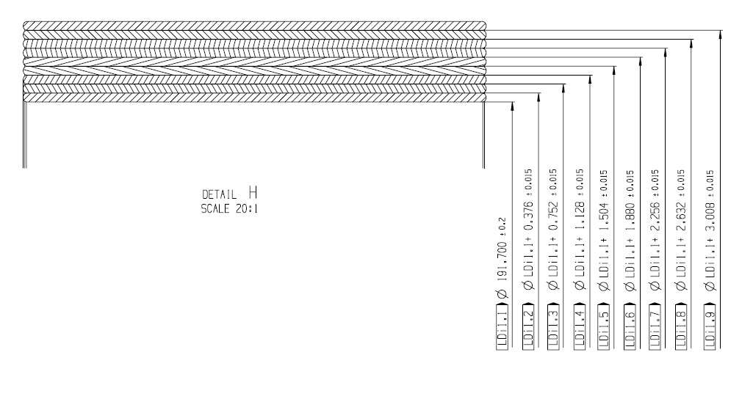
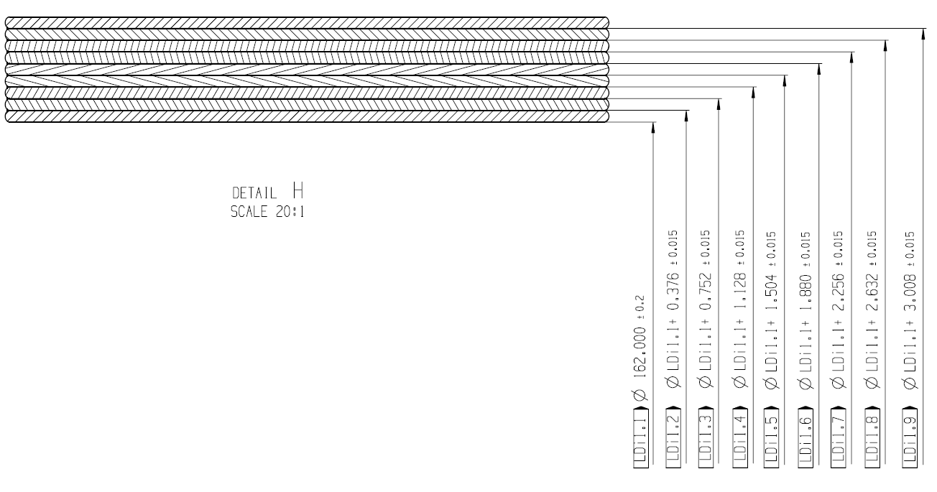
Support department for improvements
Internship experience report

Slide 15
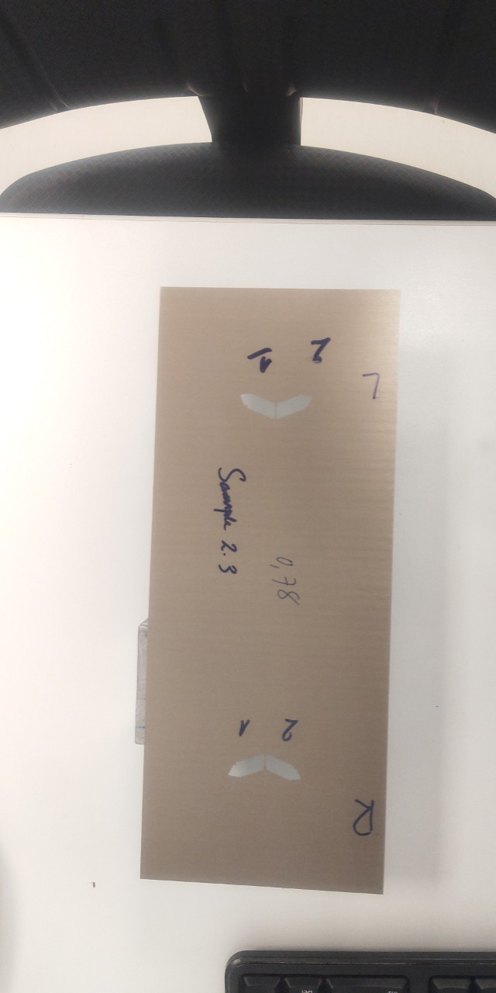
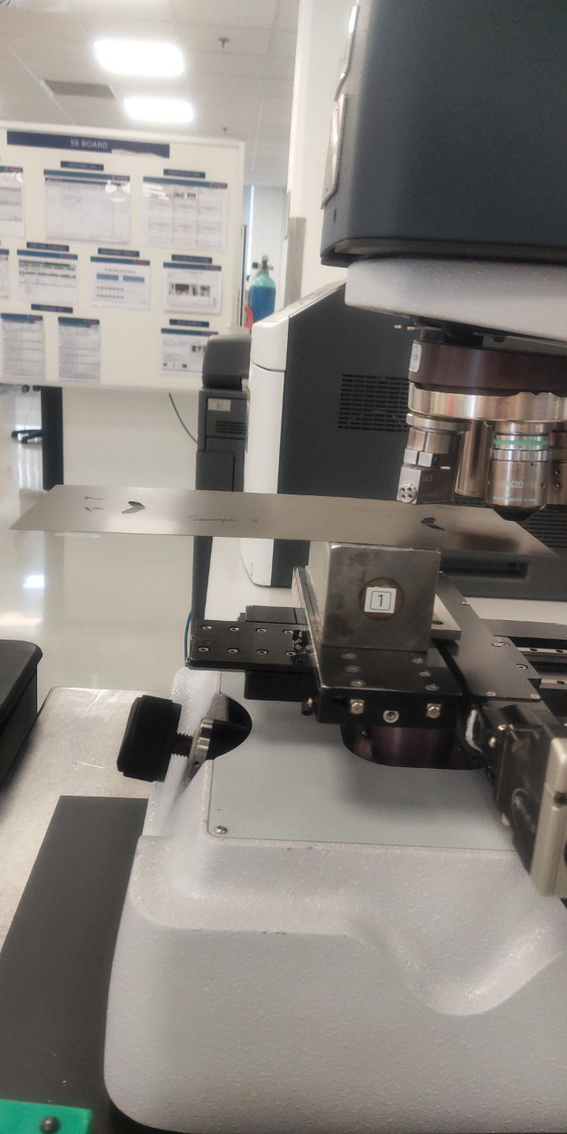
Support department for improvements
Internship experience report
2. Holder of Iron stack before.

Slide 16
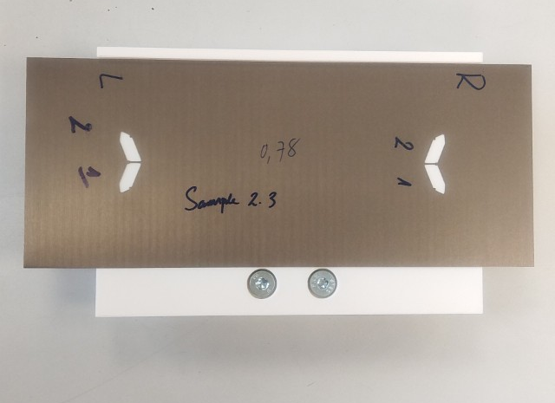
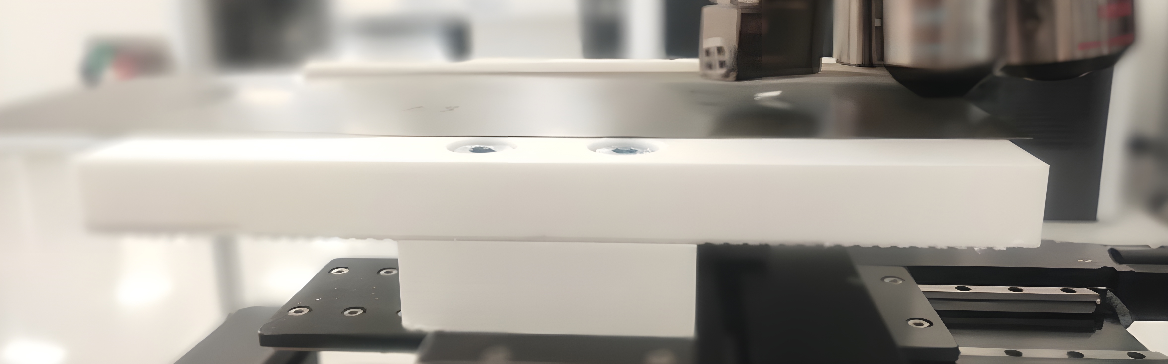
Support department for improvements
Internship experience report
2. Holder of Iron stack after.

Slide 17
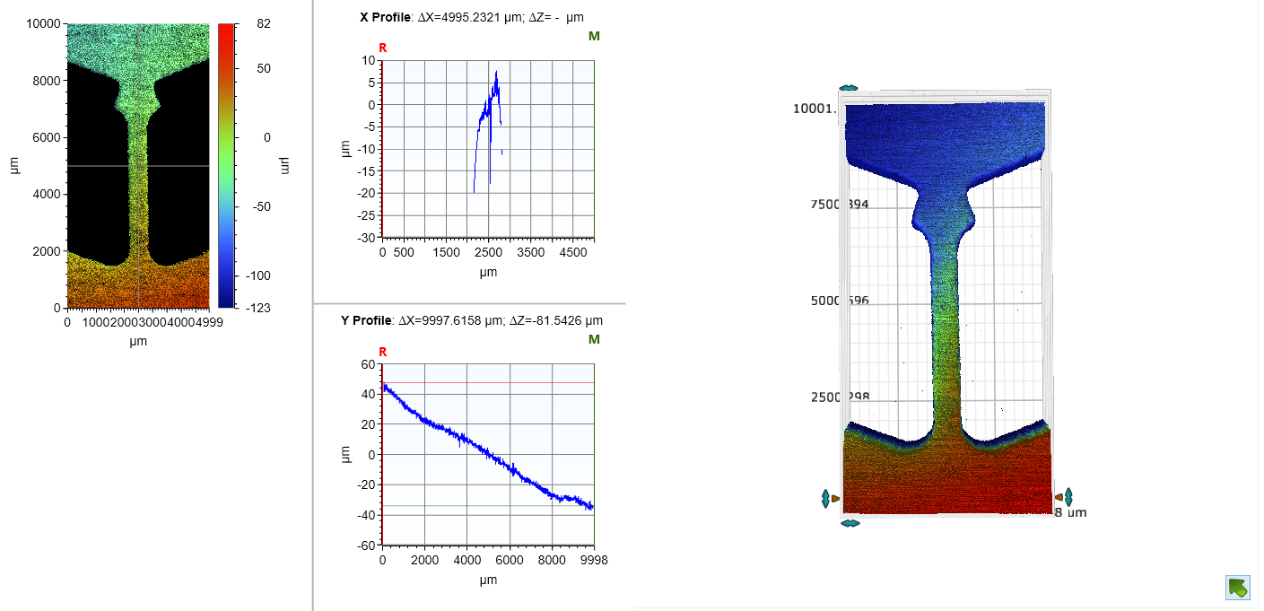
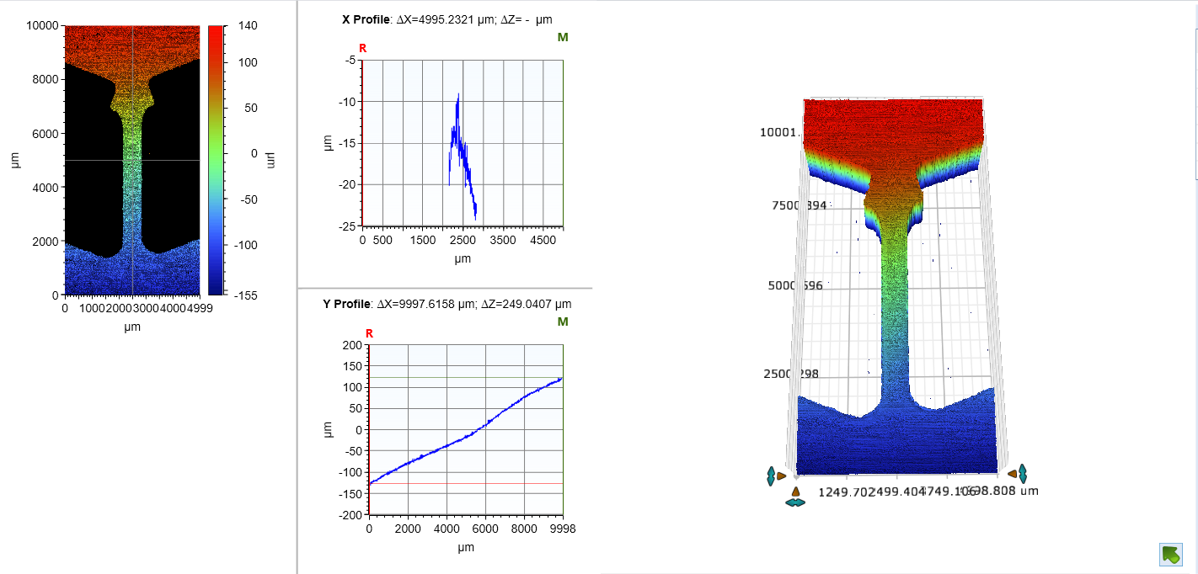
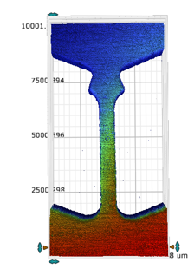
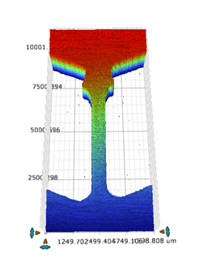
Support department for improvements
Internship experience report
2. The results of Iron stack.

Slide 18

Internship experience report

